Slide 1
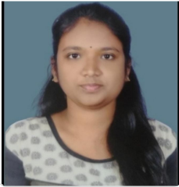
Adepu Nikhila - Developer
Overview Expertise Relevant Experience Overview
Executive Summary I am a qualified software developer with 1.10 years of hands-on experience in ERP - Microsoft Dynamics 365 Finance and Operations . Having excellent communication and problem-solving skills, confidence to achieve and can-do attitude toward any challenge are my important competencies as a software developer. Prior Experience Intern at IBM Education Bachelor of Technology(C.S.E) 2017-2021 from Marri Laxman Reddy Institute of Technology and Management , India. | Technical Expertise: Microsoft Dynamics 365 Finance and Operations. Technical Consultant. Certification: MB 300 – Microsoft Dynamics 365: Core Finance and Operations MB 500 – Dynamics 365: Finance and Operations Apps Developer Associate MB-920 – Microsoft Dynamics 365 Fundamentals(ERP) MB-910 – Microsoft Dynamics 365 Fundamentals(CRM) PL- 900 – Power platform fundamentals PL- 400 – Microsoft Power Platform Developer | Worked on several modules under Microsoft Dynamics 365 Finance and Operations. I have worked on several Priority Bugs under Microsoft Dynamics 365 Finance & Operations, a proven knowledge on Table Creation, Form Creation, Labels, Menu Items, Classes, Views, Queries, Data Entities and Data Management. Worked on Change in design bugs like label change, removing duplicate fields ,basic changes on display menu items and made some code changes. Has experience in design,developments of SSRS Reports . Has experience in creating Technical Design Document. Effective Communication skills to work in a team and always enjoy challenging tasks. Recent Projects: CCBA – COCO COLA BEVERAGE AFRICA Worked on customization of D365 F & O mainly under Finance modules.
20

